Slide 1

Digital Public Square
Healthy communities enabled by good technology.

Slide 2
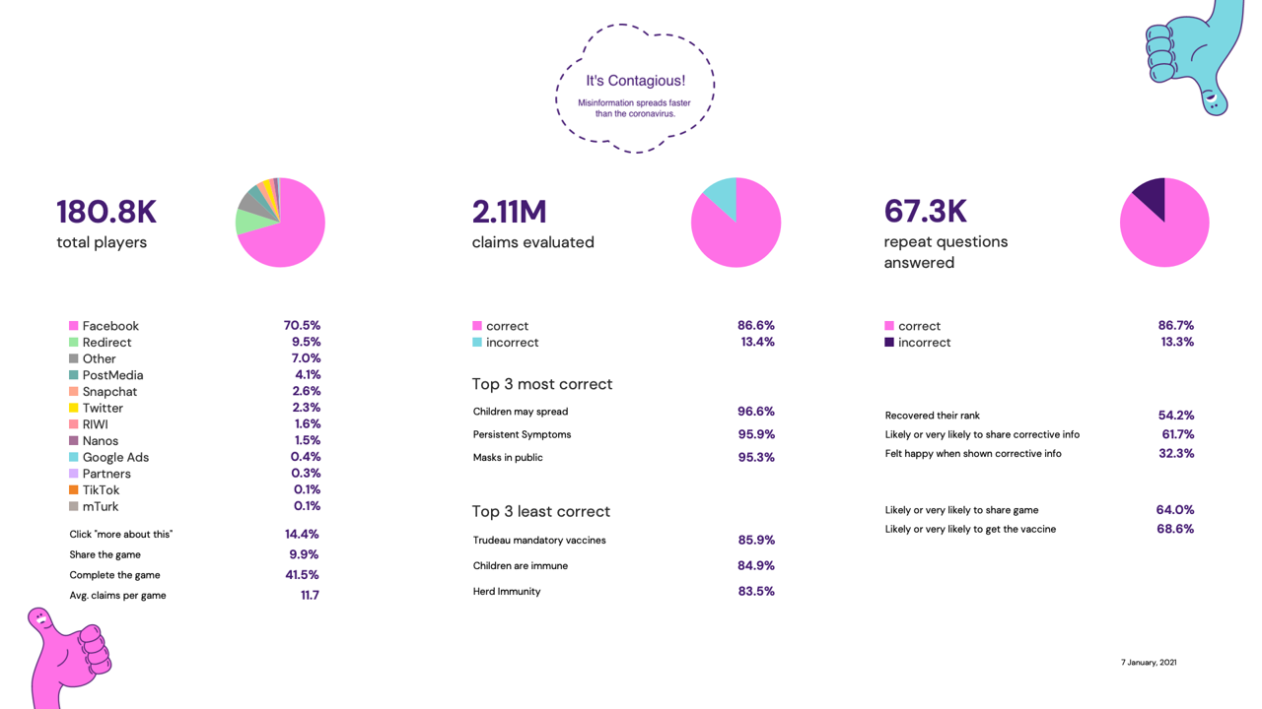

Slide 3
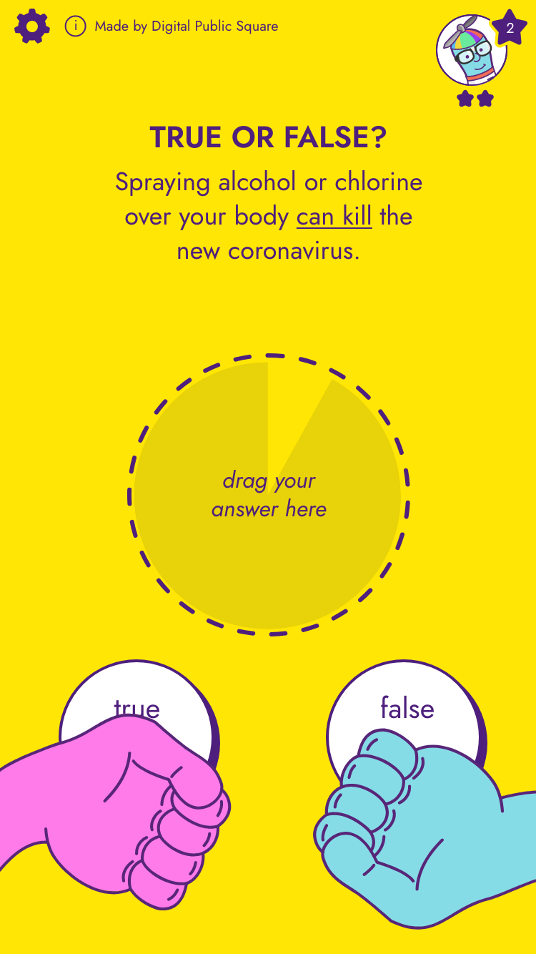
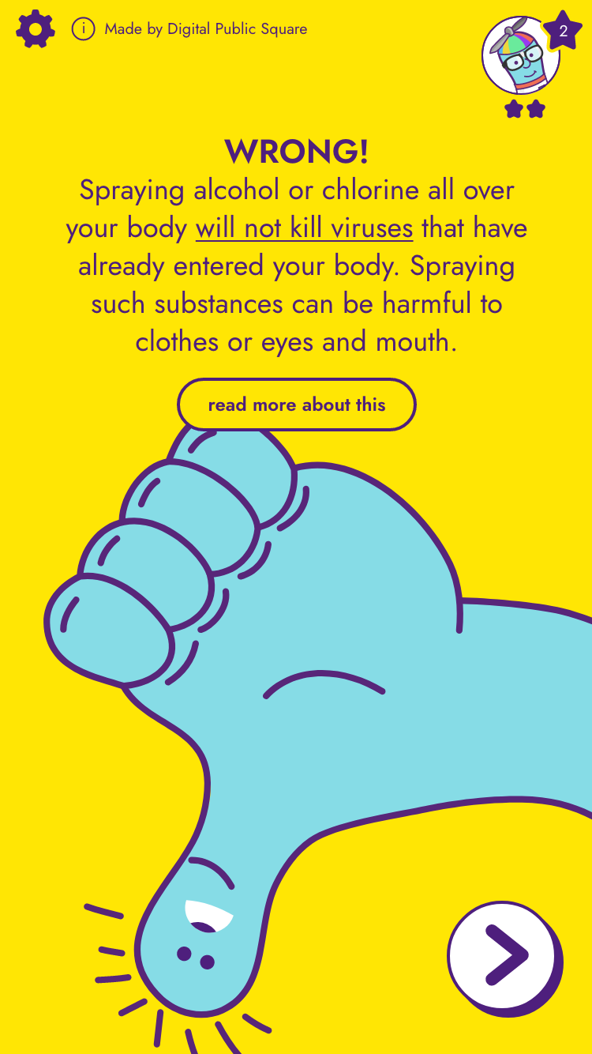
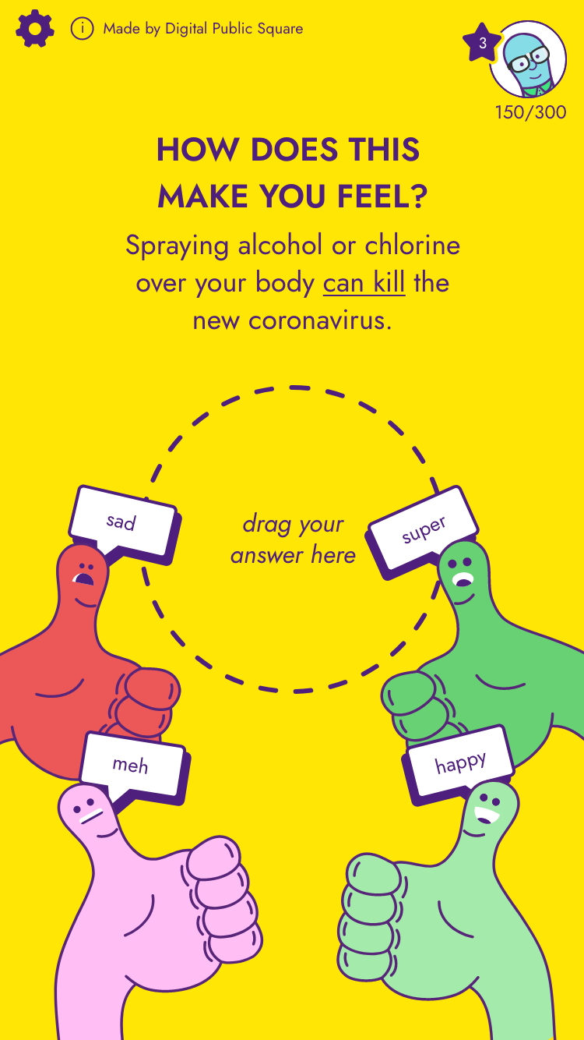
Notes:
Policies & demos

Slide 4
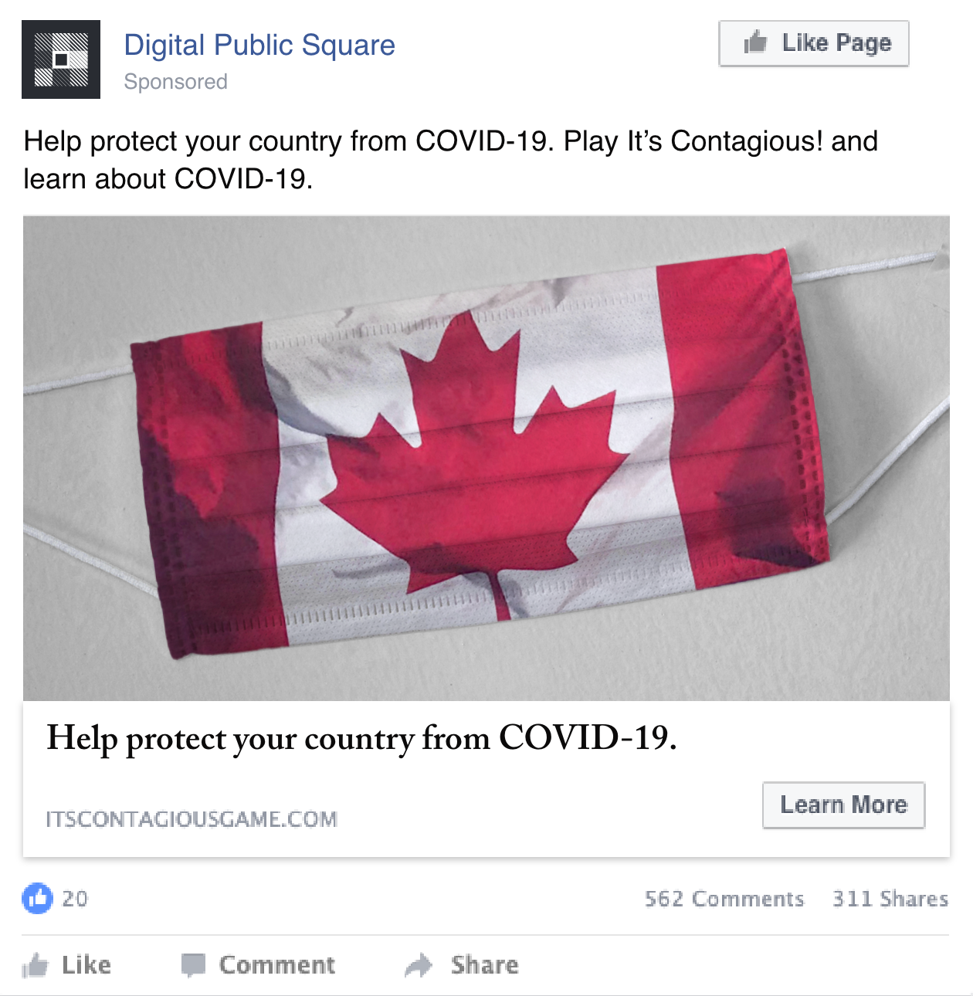
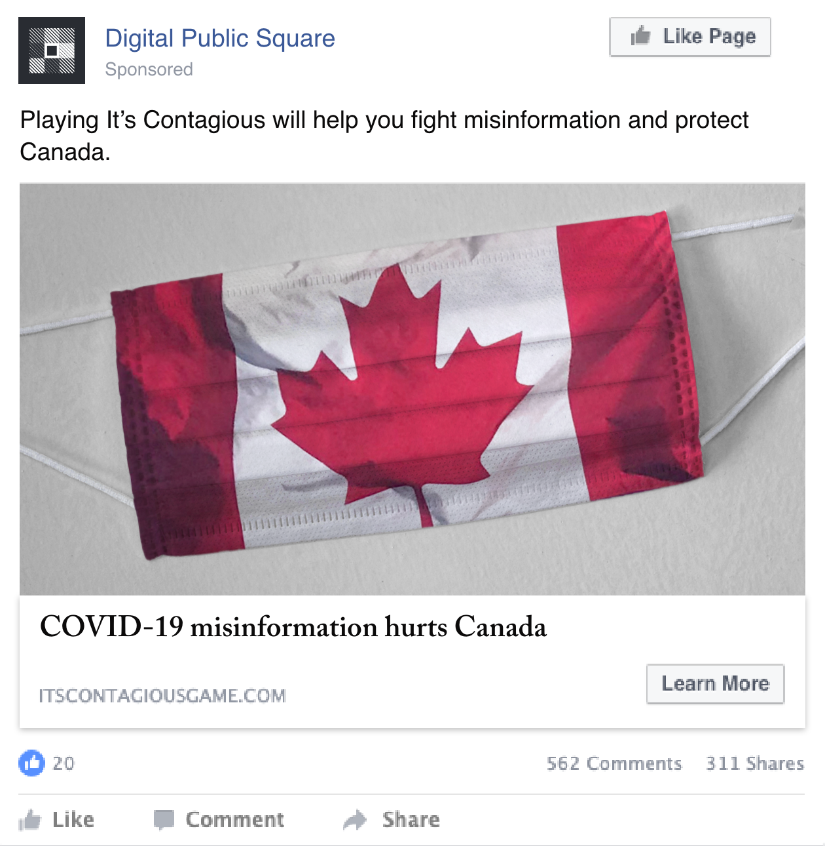
Examples: Country focused
Country focused 1a
Country focused 1b

Slide 5
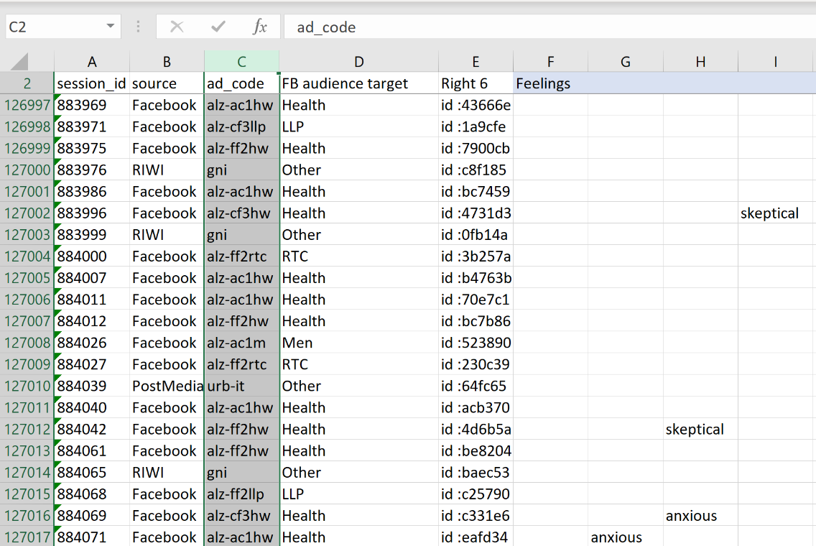

Slide 6
alz-cf2rtc
Source
(Facebook)
FB Audience
(Right-Thinking Conservatives)
Ad design
(Country-Focused #2)

Slide 7
Ad design |  | FB Audience target
ac | Accuracy | f | Young women
cf | Country-focused | llp | Left-leaning progressives
ff | Family-focused | m | Men
gf | Game-focused | nu | Northern Indigenous
 |  | hw | Health/wellness
 |  | rtc | Right-thinking conservatives
 |  |  | Parents
 |  |  | Other

Slide 8

It’s Contagious!
Social media ads

Slide 9
Game focused
Targeting:
Location: Canada
Age range: 18-65+
Interests: N/A
Keywords: N/A

Slide 10


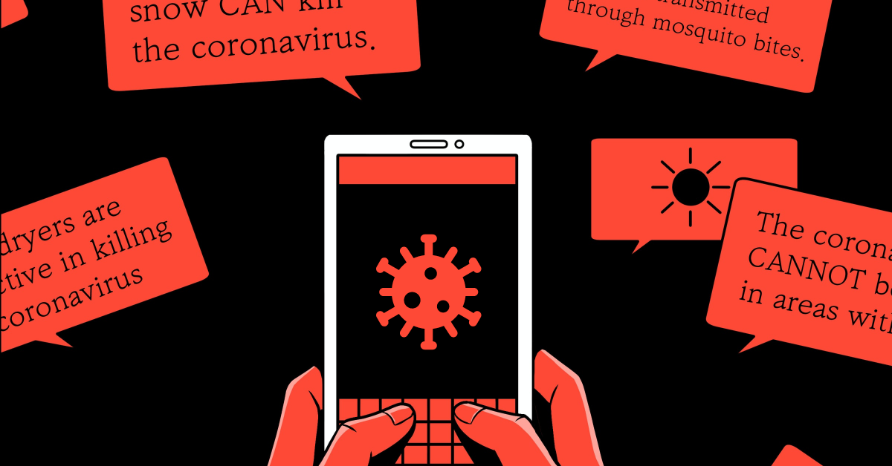

Images used
Game focused
Game focused ads directly prompt people to play It’s Contagious! as a way to have fun while debunking COVID-19 rumours, and learning new information.
Game images
Illustrations

Slide 11


Game focused
Game images
Game focused 1a
Game focused 1b

Slide 12

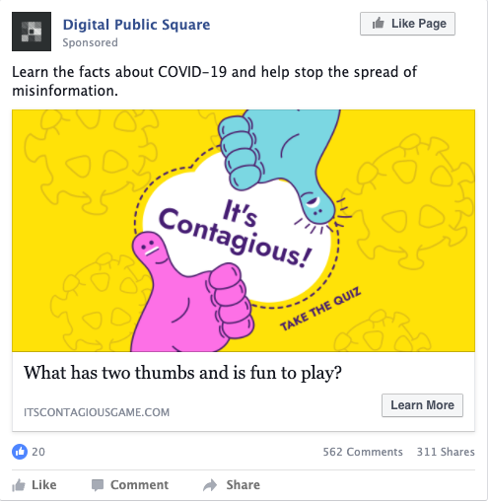
Game focused
Game images
Game focused 2a
Game focused 2b

Slide 13


Game focused
Illustrations
Game focused 3a
Game focused 3b

Slide 14


Game focused
Illustrations
Game focused 4a
Game focused 4b

Slide 15
Accuracy Focused
Targeting:
Location: Canada
Age range: 18-65+
Interests: N/A
Keywords: N/A

Slide 16


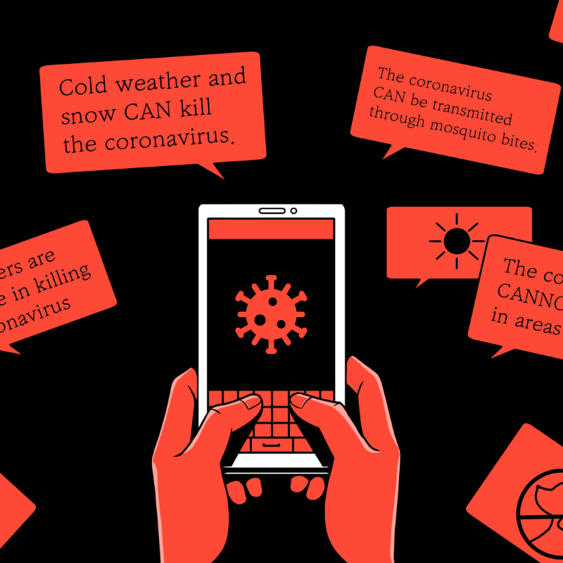

Images used
Accuracy focused
Accuracy focused ads promote the game by focusing on encouraging people to learn accurate information about COVID-19.

Slide 17

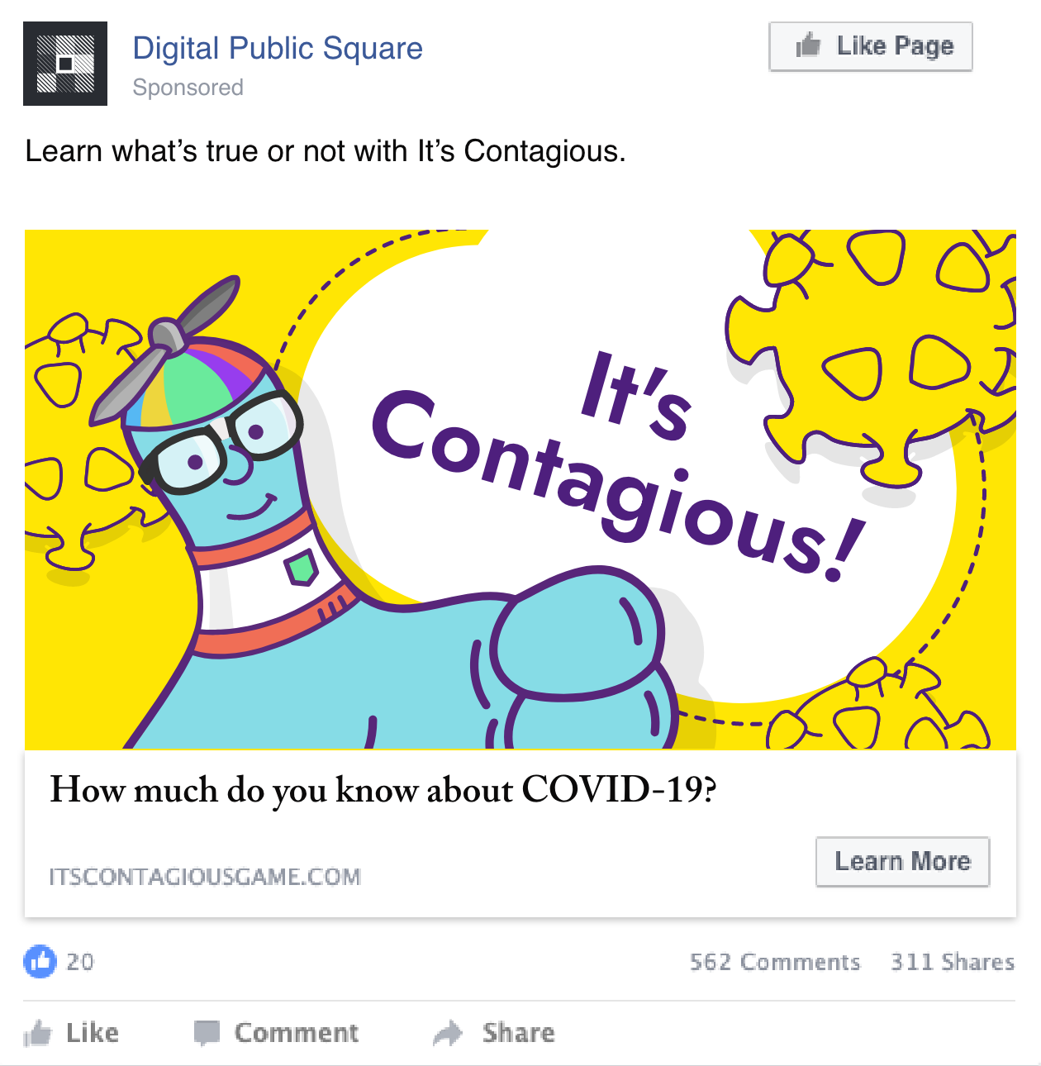
Accuracy focused
Accuracy focused 1
Accuracy focused 2

Slide 18


Accuracy focused
Accuracy focused 3
Accuracy focused 4

Slide 19
Country focused
Targeting:
Location: Canada
Age range: 18-65+
Interests: N/A
Keywords: N/A

Slide 20

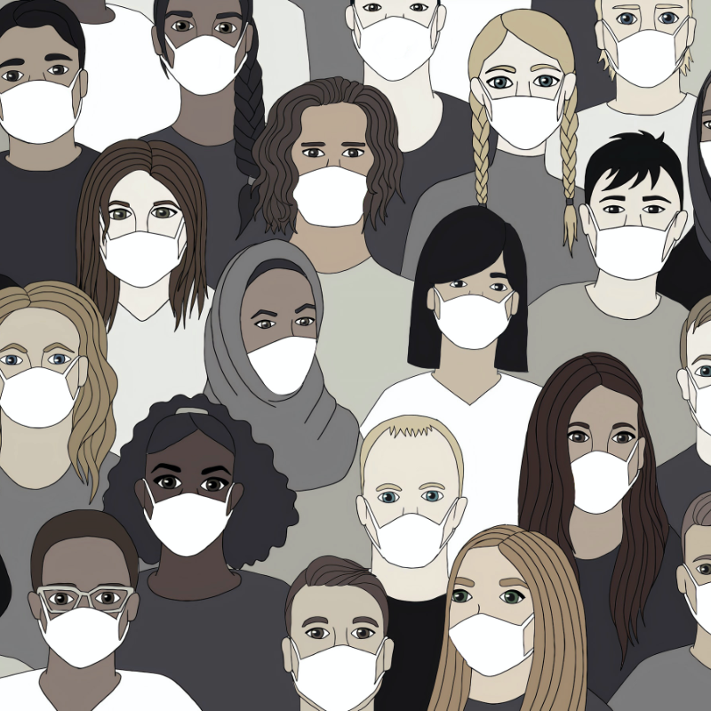

Country focused
Images used
Country focused ads state that protecting yourself from COVID-19 misinformation is a way to help protect Canada, and explains that It’s Contagious is a resource to learn about COVID-19.

Slide 21
Country focused
Country focused 1a
Country focused 1b

Slide 22
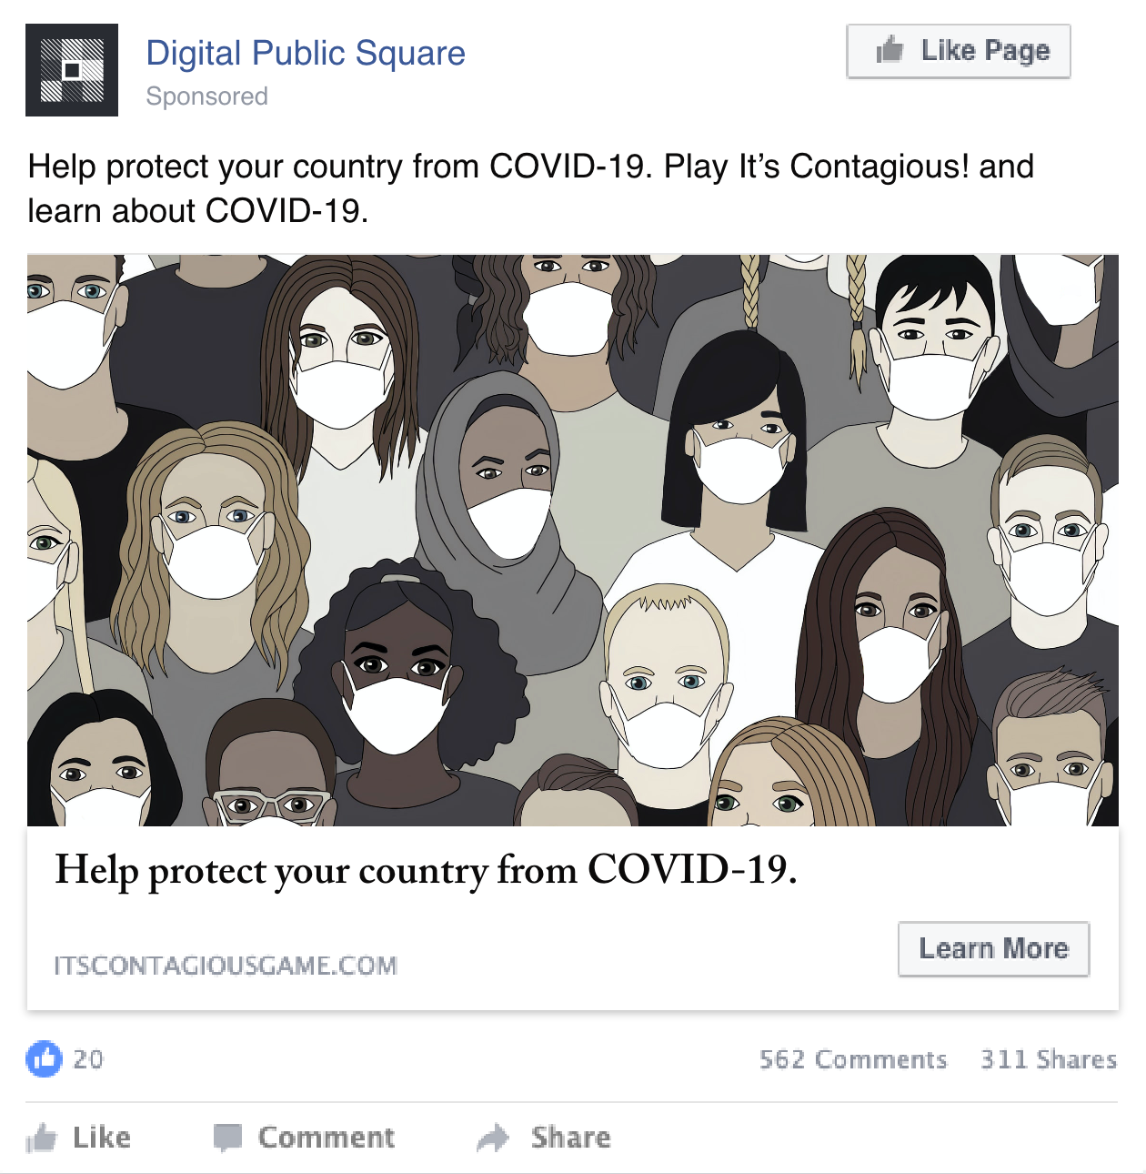

Country focused
Country focused 2a
Country focused 2b

Slide 23
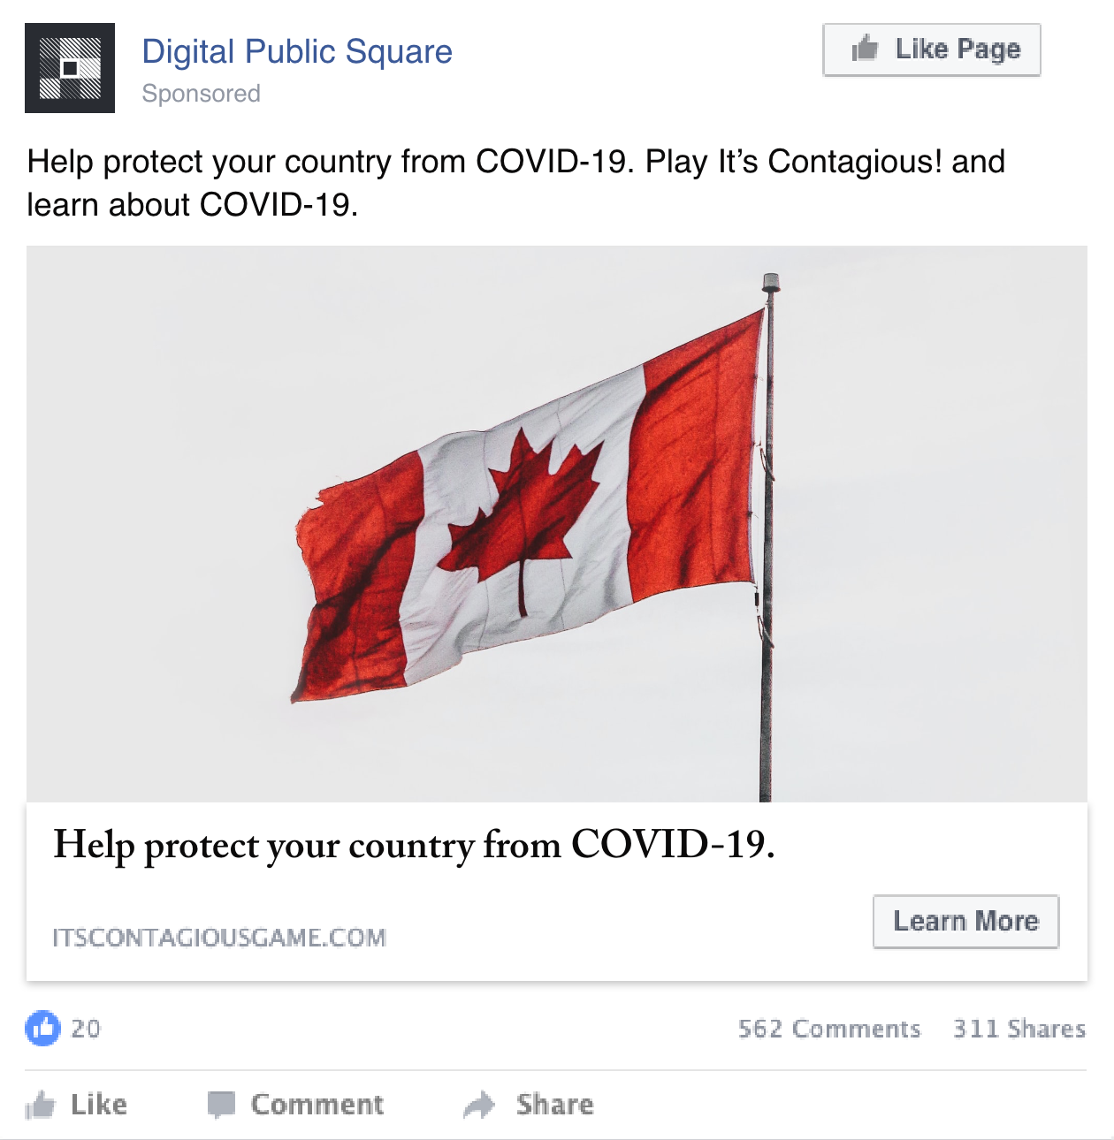

Country focused
Country focused 3a
Country focused 3b

Slide 24
Family focused
Targeting:
Location: Canada
Age range: 18-65+
Interests: Parents, Married people
Keywords: N/A

Slide 25




Family focused
Images used
Family focused ads state that protecting yourself from COVID-19 misinformation is a way to help protect your family, and explains that It’s Contagious is a resource to learn about COVID-19.

Slide 26
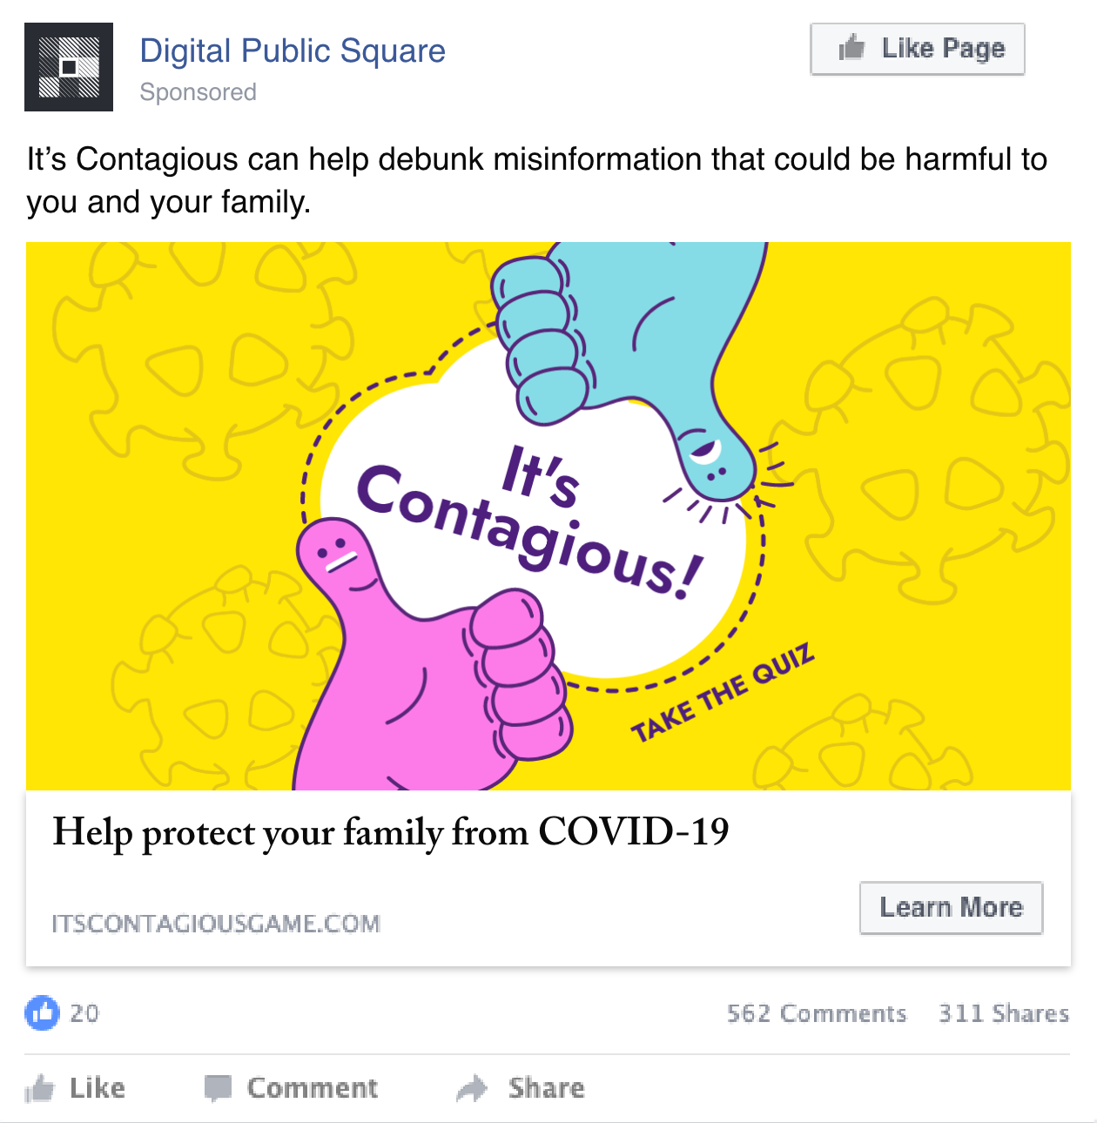
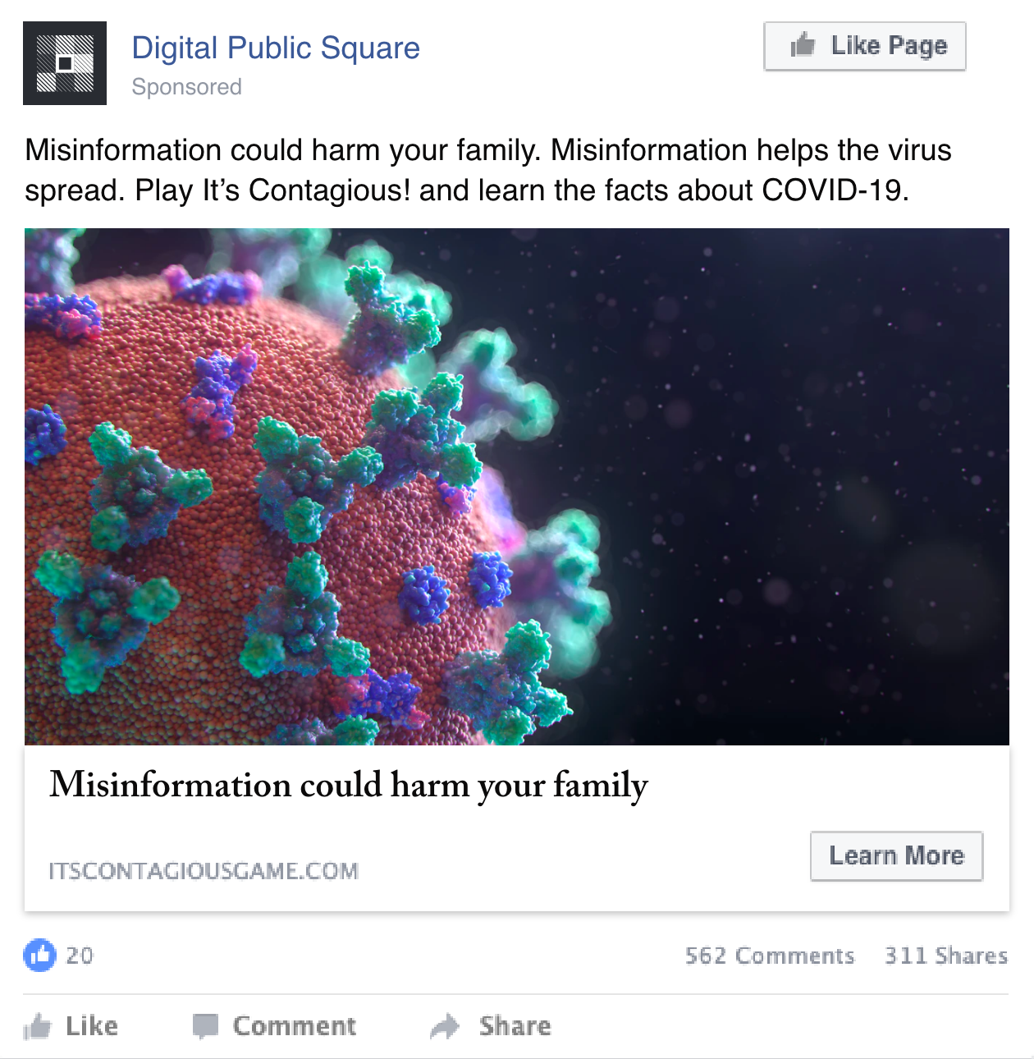
Family focused
Family 1
Family 2

Slide 27
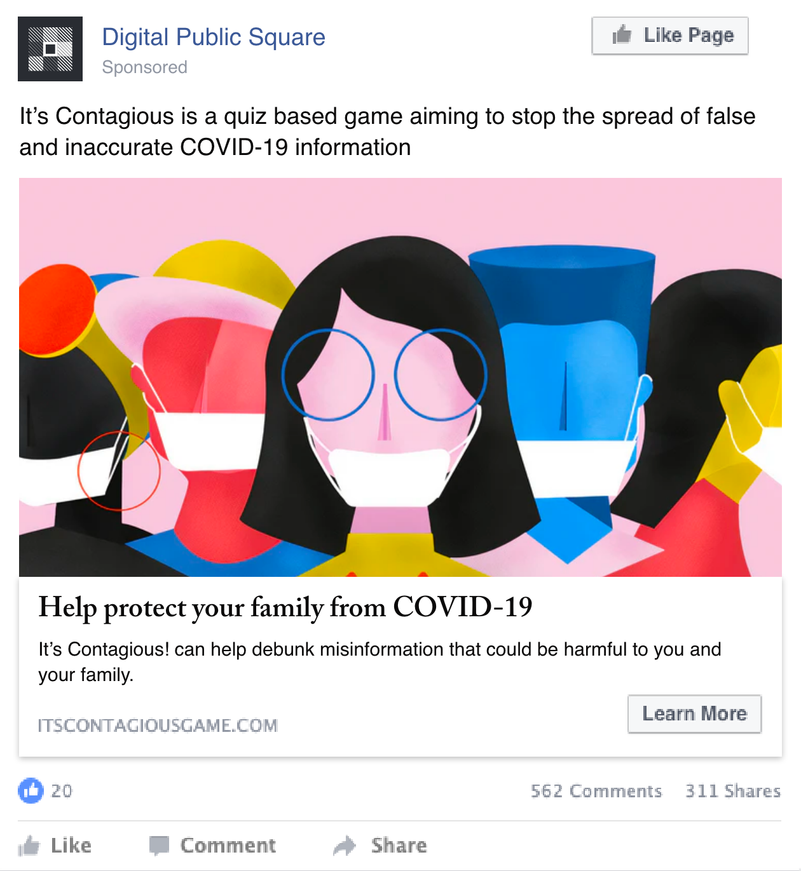

Family focused
Family 3
Family 4

Slide 28
Men
Targeting:
Location: Canada
Age range: 18-65+
Gender: Male
Keywords: N/A

Slide 29
Men
Images used
This group uses the ads that saw the most engagement in previous ad sets. The ad set targets men as a way to adjust the demographics that are reaching It’s Contagious! to be more in-line with Canada’s overall population.

Slide 30
Men

Slide 31
Men

Slide 32
Men

Slide 33
Millenial women
Targeting:
Location: Canada
Age range: 18-44+
Gender: Female
Keywords: N/A

Slide 34
Millenial women
Images used
This group uses the ads that saw the most engagement in previous ad sets. The ad set targets younger women as a way to adjust the demographics that are reaching It’s Contagious! to be more in-line with Canada’s overall population.

Slide 35
Millenial women

Slide 36
Millenial women

Slide 37
Millenial women

Slide 38
Post Media
Targeting:
Urban group¹: Greater Toronto Area (Toronto, Peel, Durham, York, Halton), Greater Vancouver Area, Greater Montreal, Winnipeg, Calgary, Edmonton, Hamilton, Ottawa-Gatineau, Kitchener-Waterloo, Quebec City, Halifax, Regina, Saskatoon
Non-Urban group: All of Canada, excluding Urban group
1: Due to human error, Post Media was initially including only the Greater Toronto Area and Calgary as part of the Urban group. This was corrected on November 24, 2020.

Slide 39



Post Media - Urban

Slide 40



Post Media - Non-Urban

Slide 41
Jack.org
Targeting:
Youth: Ages 15-24 + their parents
Geo: All of Canada

Slide 42

General

Slide 43
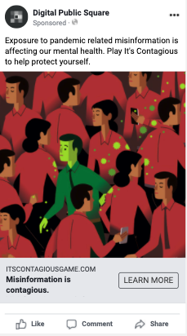
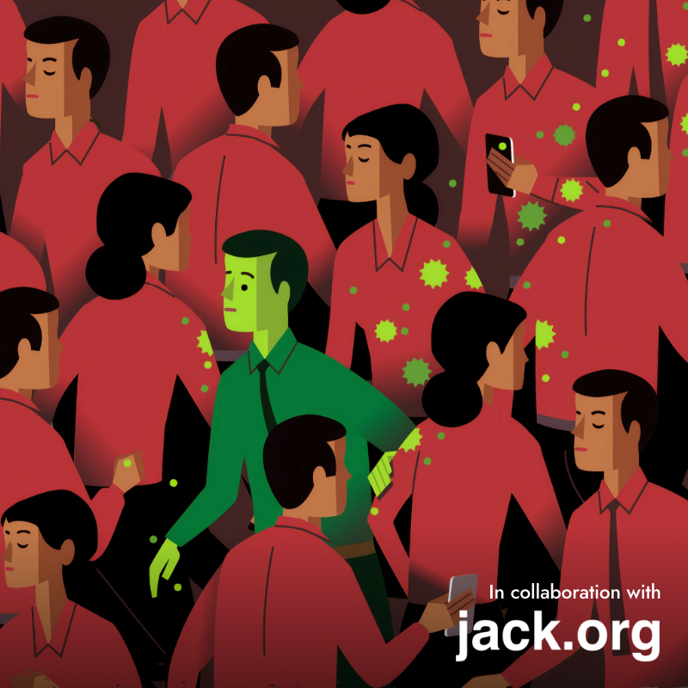
Mental Health Oriented

Slide 44

Student-Parent Competition

